Slide 1
Exposure
Notes:
the image that the digital camera sensor captures is based on the light reflected
or emitted from a subject and how much the sensor is exposed to
that light.
Camera exposure – the “how much” – is primarily based on three
settings:
• The size of the opening in the lens (aperture)
• The length of time that the sensor is exposed (shutter speed)
• The sensitivity of the sensor (ISO setting)
These three settings work together to create the exposure triangle,
and you can adjust the settings in different ways for creative results.

Slide 2
3 Things Affect Exposure
The image that the digital camera sensor captures is based on the light reflected or emitted from a subject and how much the sensor is exposed to that light.
Camera exposure – the “how much” – is primarily based on three settings:
The size of the opening in the lens (aperture)
The length of time that the sensor is exposed (shutter speed)
The sensitivity of the sensor (ISO setting)
These three settings work together to create the exposure triangle, and you can adjust the settings in different ways for creative results.

Slide 3
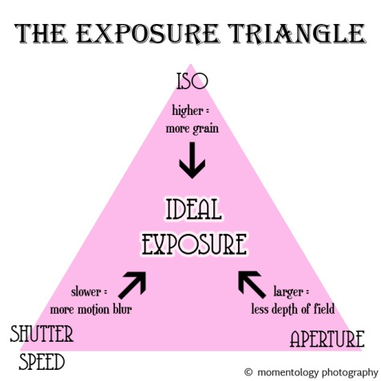
The Exposure Triangle

Slide 4
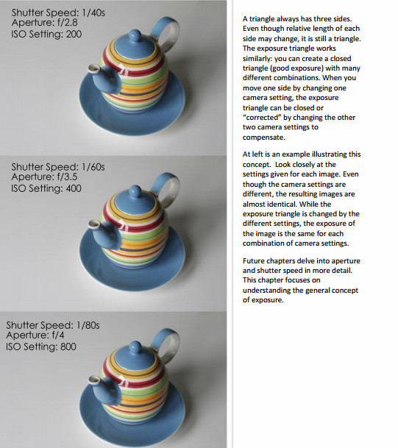
EXPOSURE SETTINGS

Slide 5
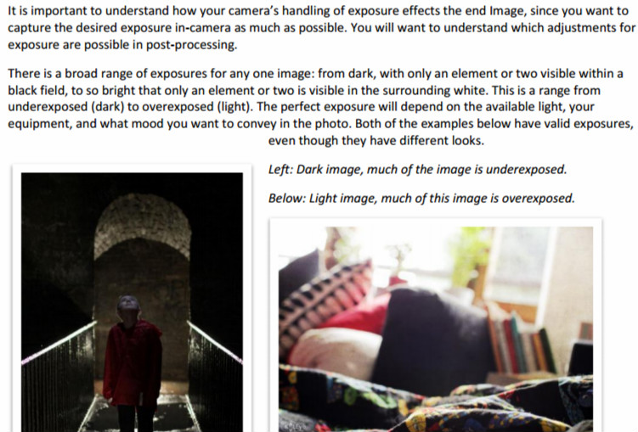
Over and under exposure

Slide 6
Over and under Exposure
Overexposure - When an area of an image is completely
overexposed, there is no detailed information recorded.
The camera fills in overexposed areas with white pixels.
This area is often referred to as being “hot” or “blown
out.” All detailed information is lost, you cannot recover
anything in post-processing in a blown out area. To the
right is an example that shows the areas in a photo where
there is no detailed information.
Underexposure - When an area of an image is completely
underexposed, the sensor responds in a similar, but
opposite manner. The pixels in the underexposed region
are filled in with black.

Slide 7
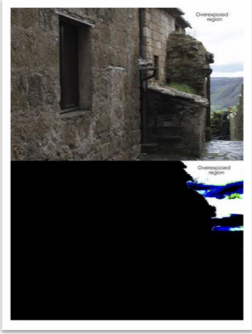
Over and under exposure
Under exposed
Over exposed

Slide 8
USING THE HISTOGRAM TO VISUALIZE EXPOSURE
In most digital cameras, you can review the image on the LCD after it is captured. While this is good for assessing composition and gives a general idea of how the image will look on the computer, it can be an inadequate
method to quickly assess if the image has over- or underexposed regions.
A histogram shows you how the image is exposed from dark (left
side, black or “0”) to light (right side, white or “255”).

Slide 9
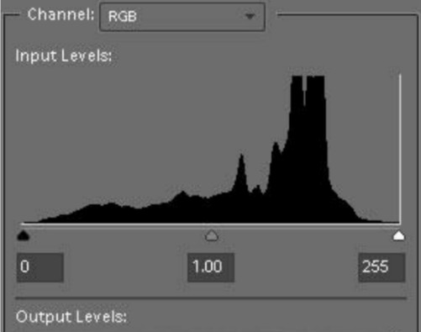
histogram

Slide 10
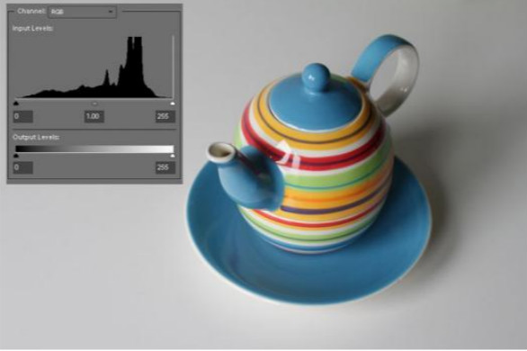
histogram
You can see how the histogram fits the image. Most of the image is light (the white background) with some medium color and no
areas that are very dark.

Slide 11
overexposure
If the exposure data is more heavily weighted
toward the right side of the histogram, with
nothing on left side, your image may be
overexposed.
The overexposure can be adjusted later in software if there are no peaks cut off at the right edge.

Slide 12
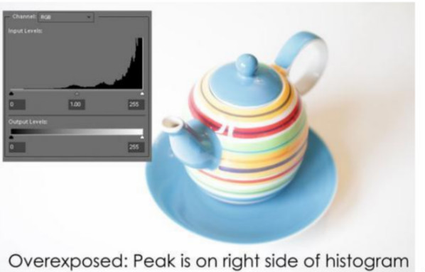
overexposure

Slide 13
Under exposure
If the histogram has peaks toward the left (black side), with little data on the right side, your image could be underexposed.
Underexposure can be adjusted later in software if there are no peaks cut off at the left edge.

Slide 14
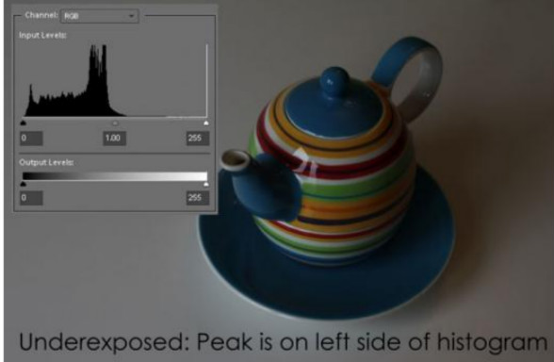
Unde exposure
Image is significantly underexposed, but no detailed information is lost because the peak is not cut off on the left side.

Slide 15
Under exposure
While you can make adjustments and recover an image in post-processing, unwanted noise and a reduction of detail information is likely if the exposure is significantly off.
More detailed information is captured in the lighter parts of the spectrum, on the right side of the histogram.
Unless you are choosing to underexpose an image for an artistic reason, you won’t want to significantly underexpose most of your images

Slide 16
Using the histogram
To use the histogram, set your camera to a
review mode where you can see the histogram
along with the thumbnail of the photo.

